Slide 1
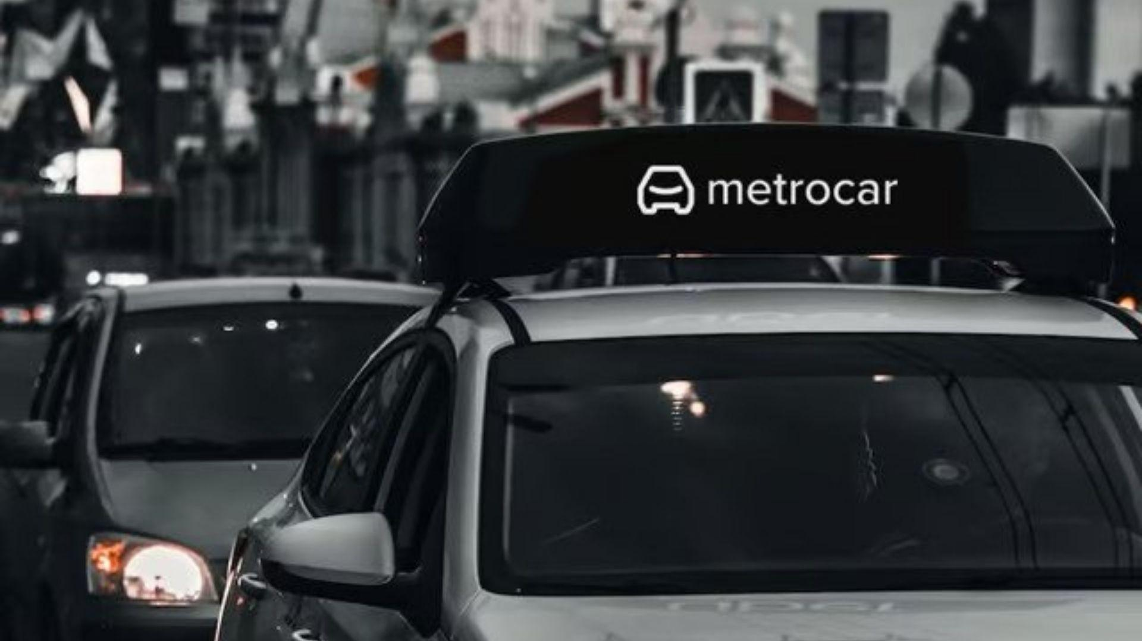
Metrocar
Funnel Analysis
Daniele D’Epiro

Slide 2
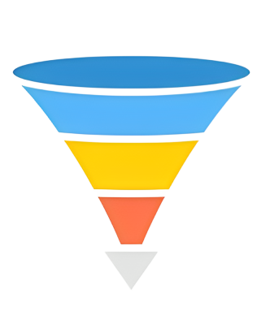
Understanding the Power of Funnel Analysis
Quantifying Drop-off: Identify where users exit the funnel and understand bottlenecks.
Identifying Causes: Uncover the reasons behind attrition and address root causes.
Taking the Right Actions: Develop data-informed strategies to improve user engagement and conversion.

Slide 3

Metrocar's User Funnel
App Download
Signup
Request Ride
Driver Acceptance
Ride
Payment
Review

Slide 4
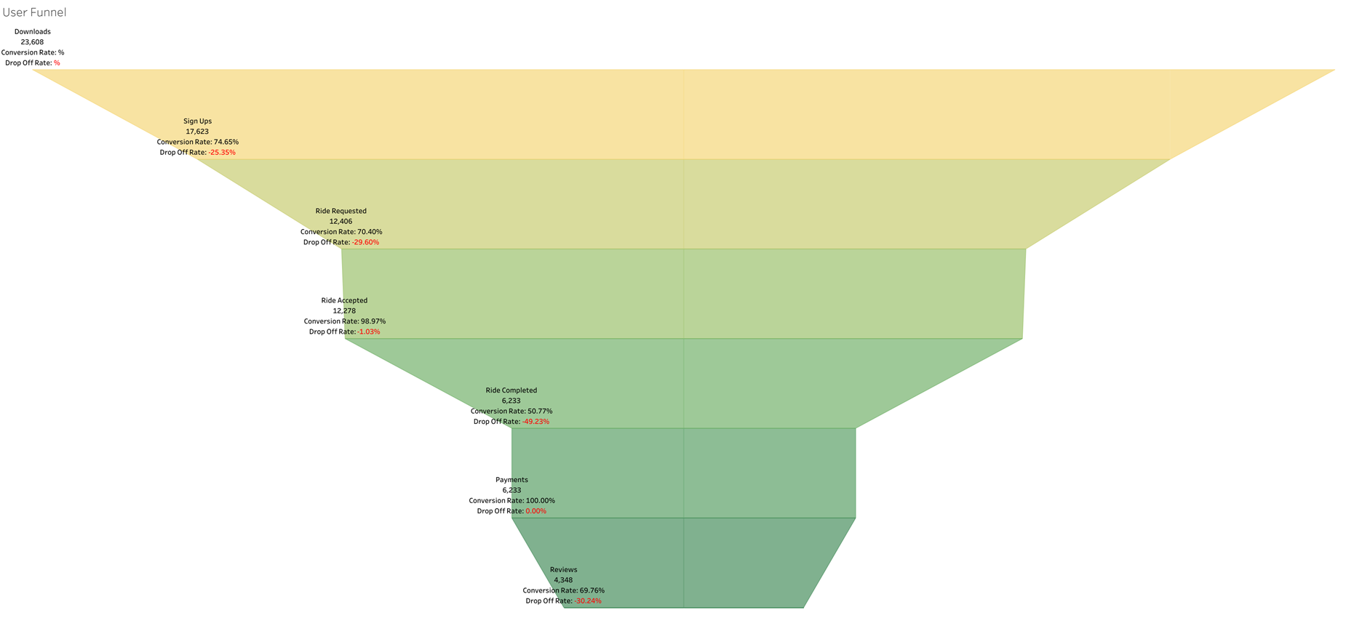
What steps of the funnel should we research and improve?
Drop-off between "Rides Accepted" and "Completed" is significant (50% drop)
Waiting time impacts cancellation rates
Promoting multiple user ride-sharing option

Slide 5
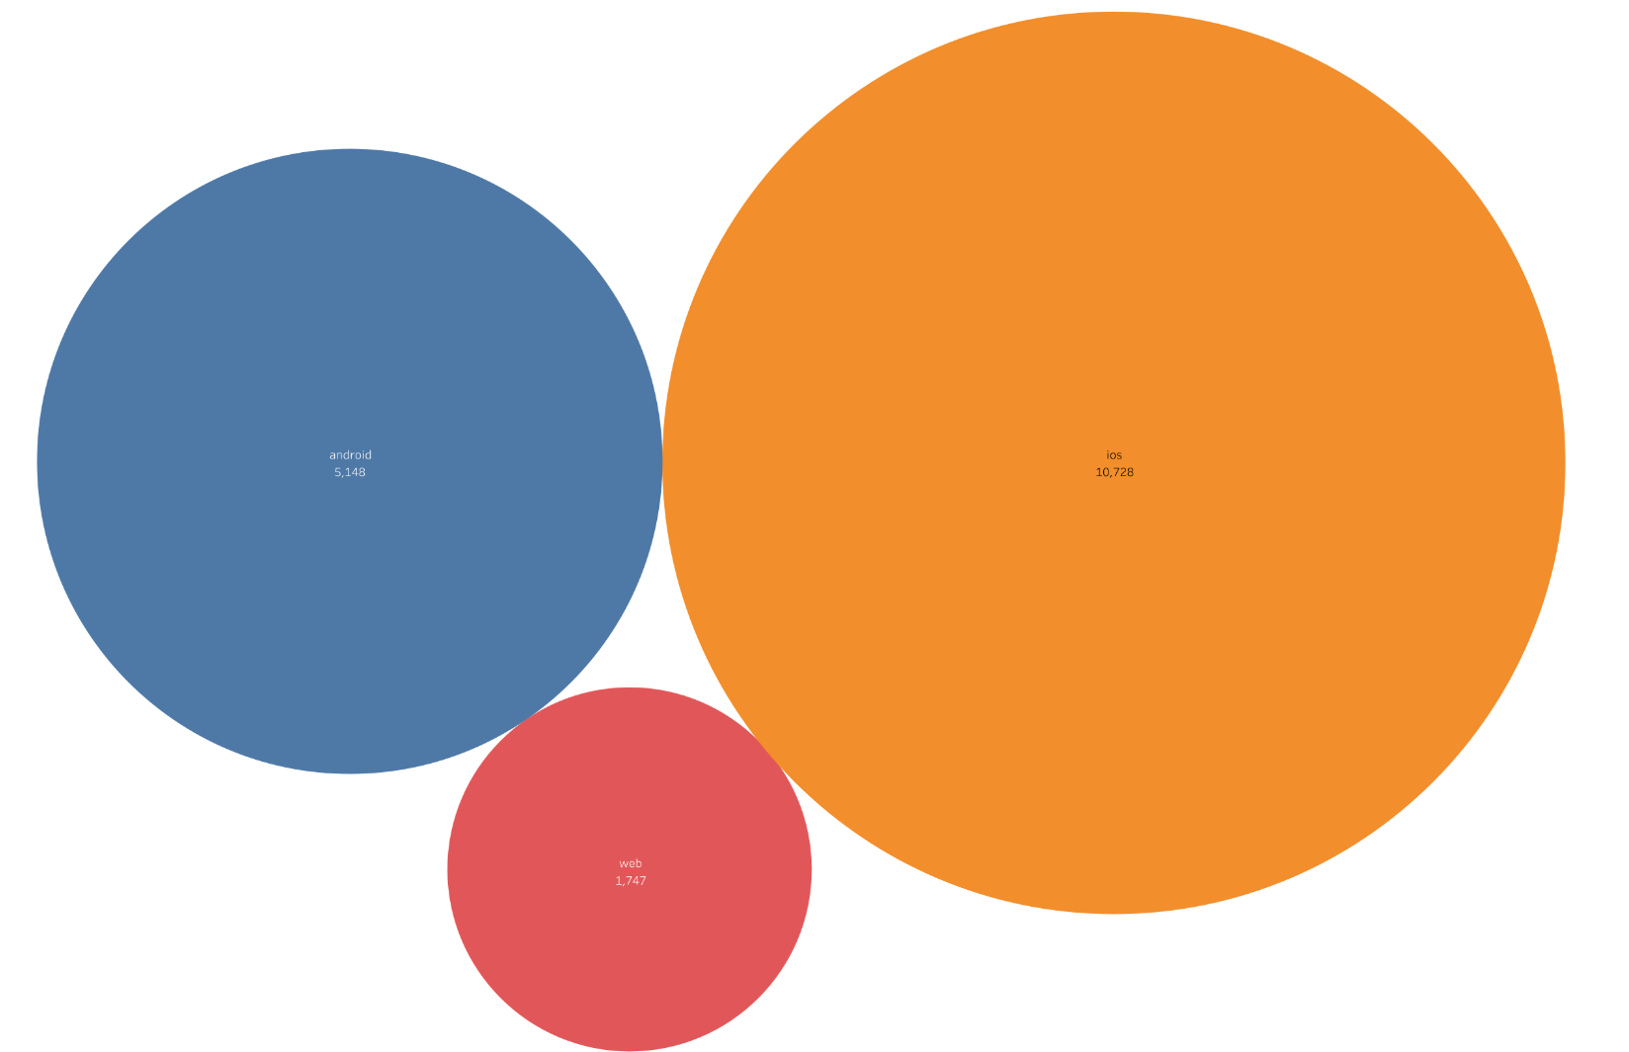
Where to focus marketing budget based on platforms?
Allocate budget primarily to iOS, the best-performing platform
Reduce web channel budget due to underperformance
Consider reallocating the web reduction to Android due to its wider user base

Slide 6
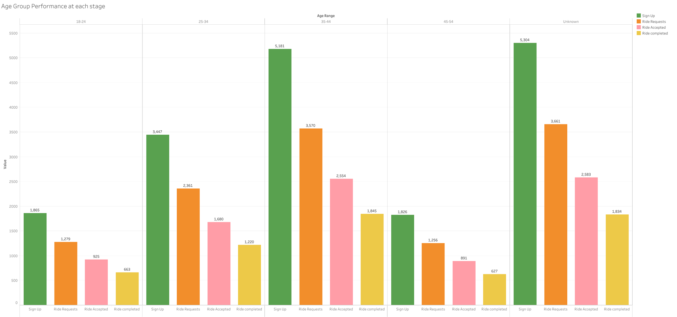
Which age groups perform best at each stage?
Ages 35-44 have the highest user performance
Consider focusing on age groups 25-34 and 35-44
Note that many users did not share their age

Slide 7
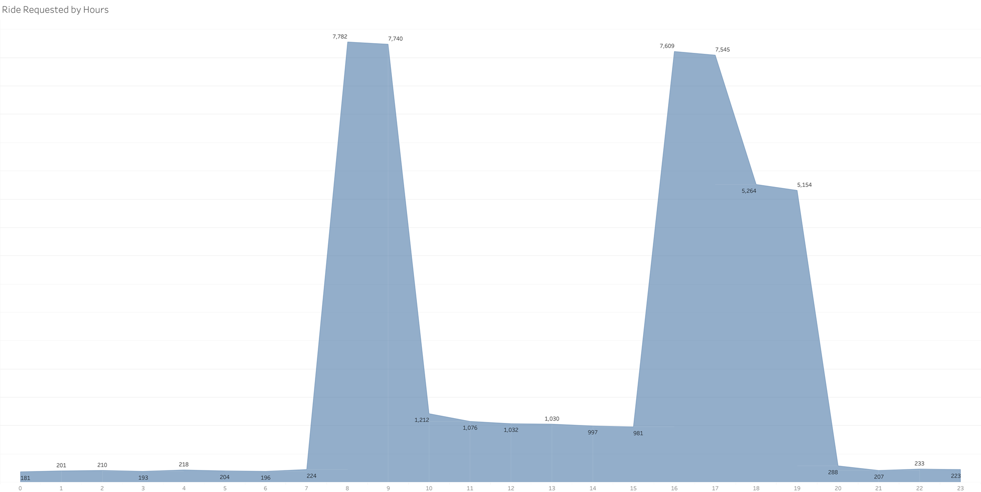
What does the distribution of ride requests look like throughout the day?
Two daily peaks: 8-10 AM and 4-8 PM
Surge pricing can help balance supply and demand
Be cautious about negative impacts on reputation and customer churn

Slide 8
What part of our funnel has the lowest conversion rate?
Lowest conversion rate at the "Ride Completed" stage.
Suggest offering a discount voucher after a user completes his first ride

Slide 9
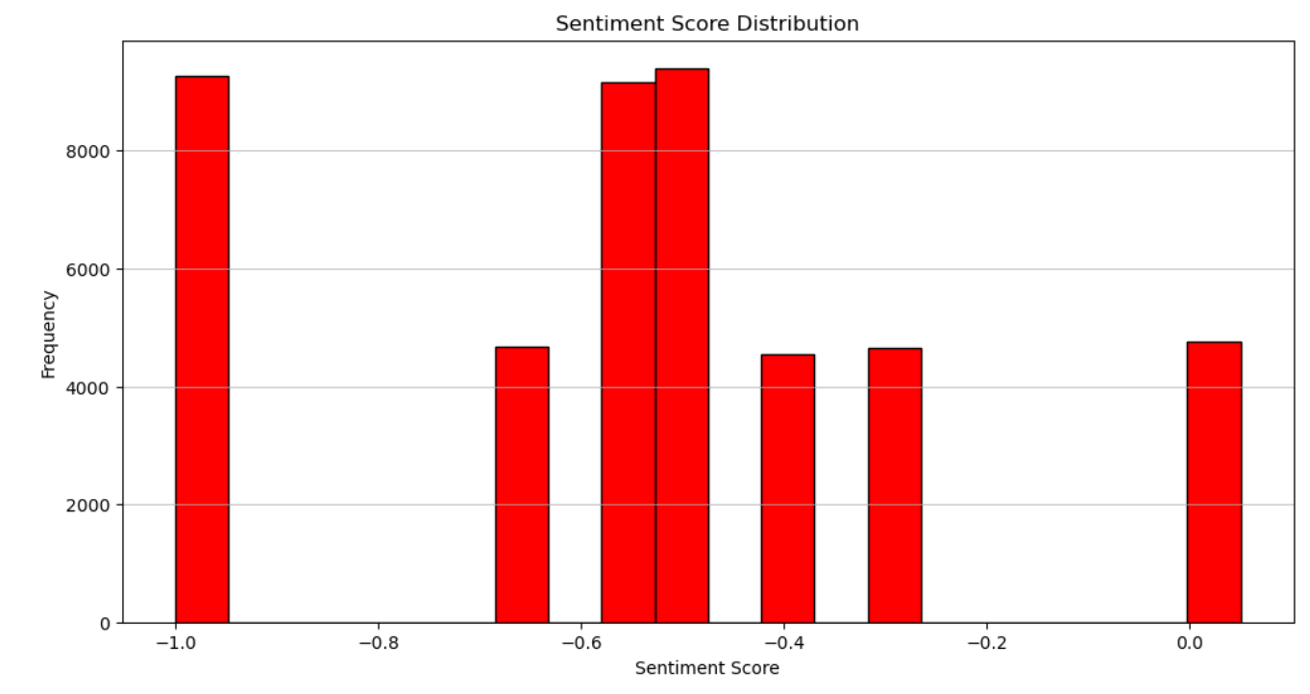
Sentiment Analysis of User Reviews
Very negative Sentiment Score
Lots of negative adjectives
Driver was the most present noun

Slide 10
Final Recommendation
Reduce Ride Cancellation Rate:
Price Surging
Ride-Share Option
Discount after first ride
Marketing Focus:
iOS platform
Age Group 35-44 and 25-34

Slide 11
Thank You!

